Slide 1
TEMPO TIME CREDITS
Carwen Davies
Communities & Partnerships Manager North and S West Wales
February 2022

Slide 2
THANKS…
Before we start today…
Thank you for attending the session
Thanks for showing an interest in Tempo Time Credits
We hope you find this session informative!

Slide 3
DIGITAL CONNECTIVITY SESSION
What we’ll be covering today:
How Tempo Time Credits work
An update on how we’re doing in Wales so far
A digital dashboard demo
The importance of exchanging Paper Time Credits

Slide 4
OUR VISION
A World in which communities build themselves through enabling more individuals and more diverse groups of people to volunteer and support their local communities, with paid and voluntary work being accorded greater parity in the measurement of our national wealth.

Slide 5
ABOUT TEMPO:
We co-design and deliver Tempo Time Credits networks in
partnership with local authorities, health, social care and housing providers, schools, businesses and voluntary sector organisations, inspiring people of all ages and backgrounds to get involved.​​

Slide 6
WHAT ARE TIME CREDITS?
Tempo Time Credits are a community tool to engage more people in volunteering and community participation
​
Volunteers receive recognition for their contributions by earning Tempo Time Credits and use them with a range of local and national Recognition Partners across Wales and England
Over 1 million Time Credits have been earned by over 56,000 volunteers

Slide 7
UPDATED FIGURES FOR TEMPO TIME CREDITS CYMRU

Slide 8
Current figures:
Community/earn groups: 418
Volunteers: 2,504
Time Credits earned: 16,009
February 2022

Slide 9
DEMO OF OUR DIGITAL PLATFORM

Slide 10
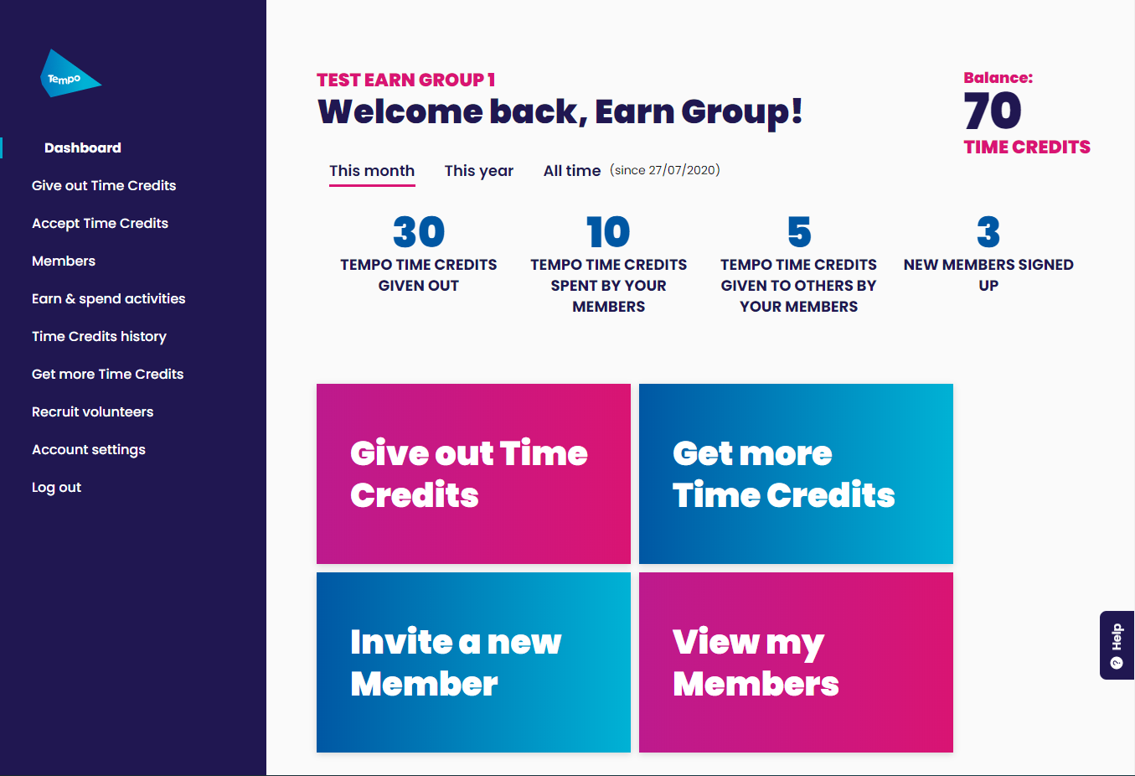
DIGITAL TIME CREDITS
For volunteers - Their online account allows them to check their balance and find new ways to earn and use Tempo Time Credits all in one place, via their phone or computer.
For community organisations – The easy-to-use system means no more reporting and they can see if and how their volunteers are using their Tempo Time Credits.

Slide 11
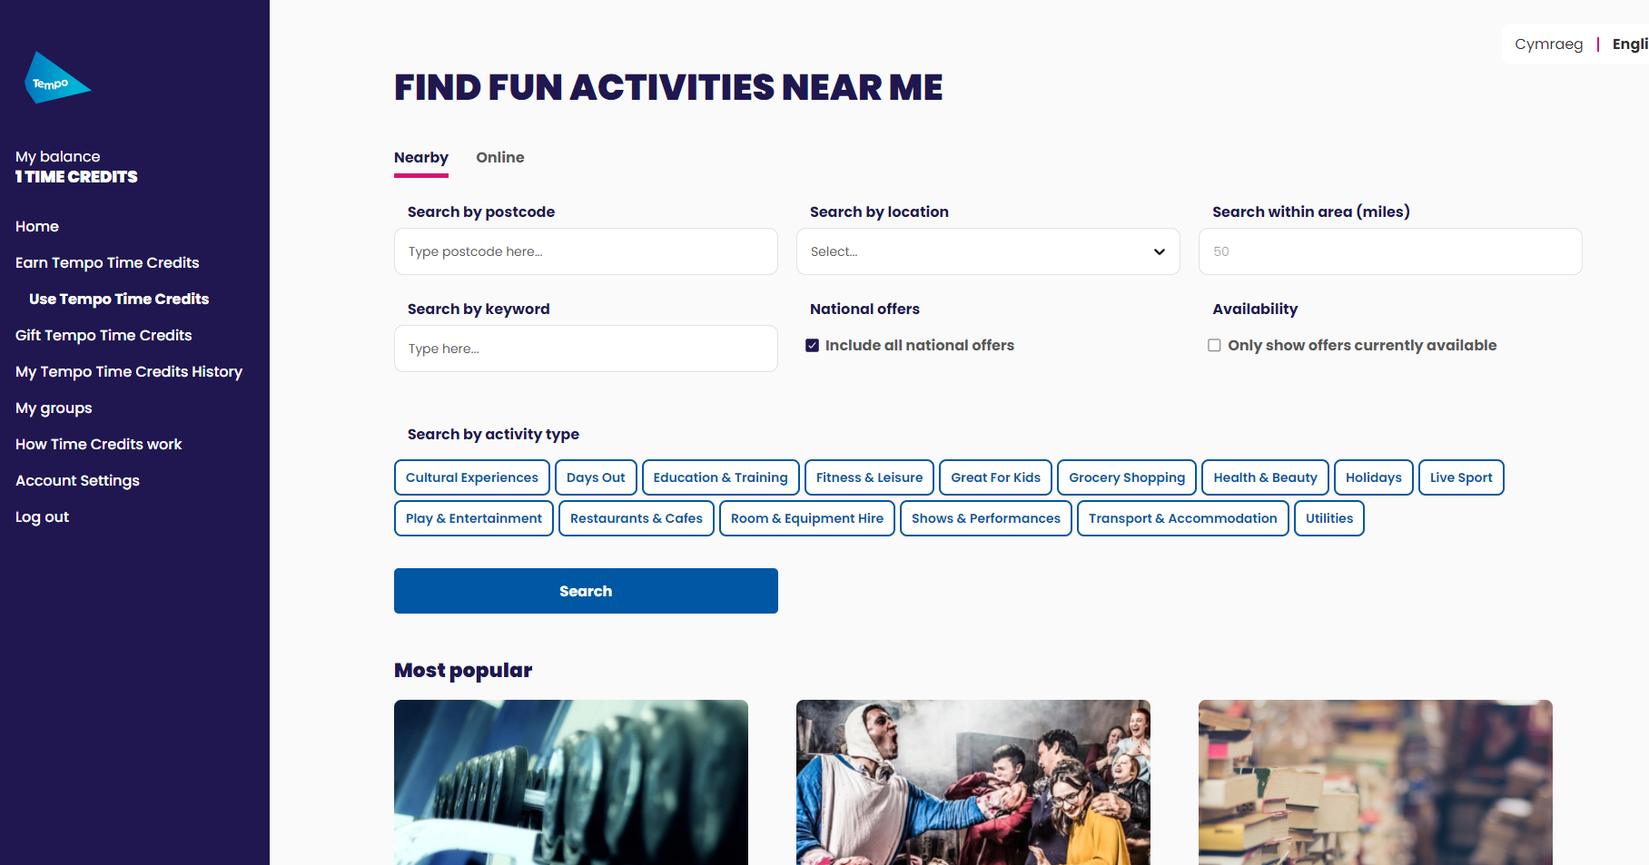
Volunteers can choose what activities/resources they want to use their Time Credits on by searching by area or activity type

Slide 12
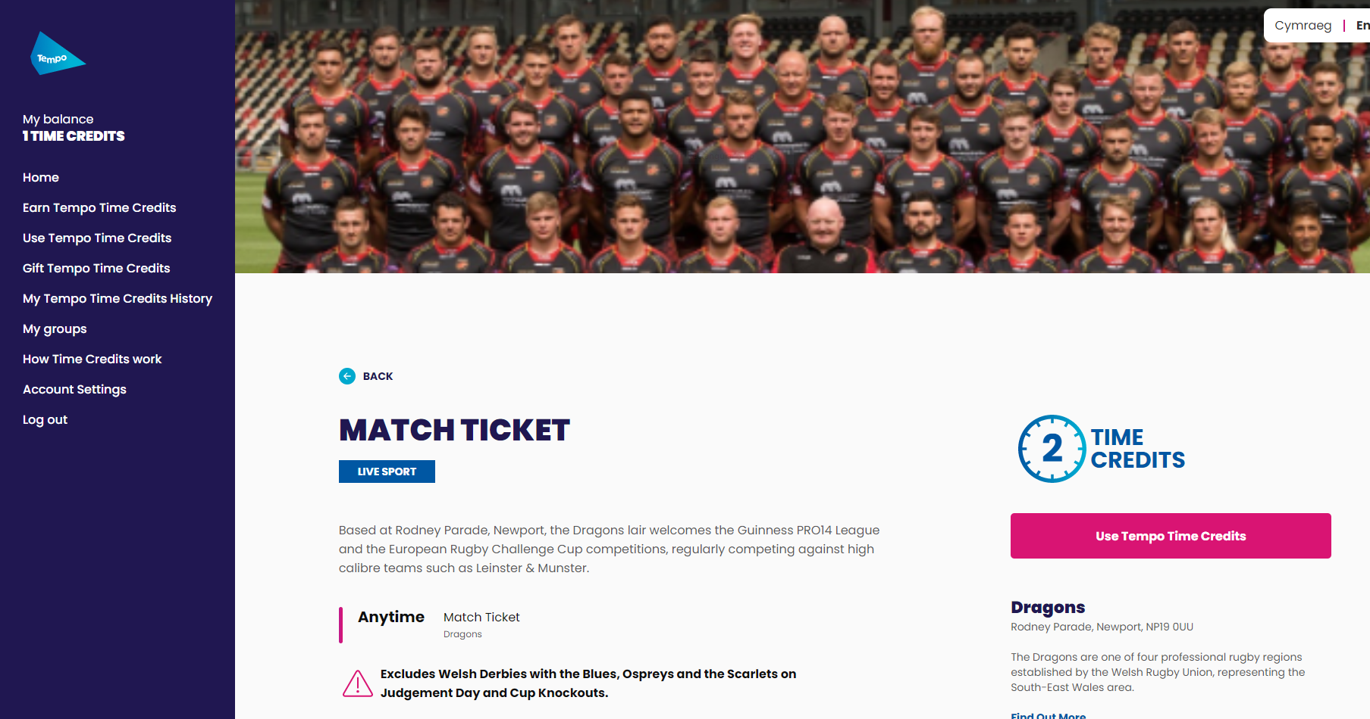
Once they have selected an activity, they can view that offer, check for any restrictions and make the booking by clicking USE TEMPO TIME CREDITS

Slide 13
PAPER TIME CREDITS WILL EXPIRE ON MARCH 31st 2022…!
HOW TO EXCHANGE YOUR PAPER TIME CREDITS
SIMPLY….
Post your Paper Time Credits to:
Freepost Tempo Time Credits
Include the following information:
Full name
Email address
Tempo ID number
Your Time Credits will then be credited to your digital account

Slide 14
THANKS!
ANY QUESTIONS?

