Slide 2
Today’s Session
About the Act
Legal duties
Well-being Goals, the Five Ways of Working and National Indicators
PSBs and Well-being Plans
Our work with the Voluntary Sector
Collaboration
Some examples

Slide 3
Introduction to The Act and the role of the Office of the Future Generations Commissioner

Slide 4
In a nutshell, the Act
Imposes a duty on specific public bodies to carry out sustainable development – no choice, an obligation and it uses a wide definition of SD​
Sets a vision and ‘steps’ to reach a better Wales ‘The Wales We Want’​
Creates a delivery system: Goals, objectives, ways of working​
Establishes a tracking system and controls to ensure the new system is working - including the Future Generations Commissioner, annual reporting and national indicators

Slide 5
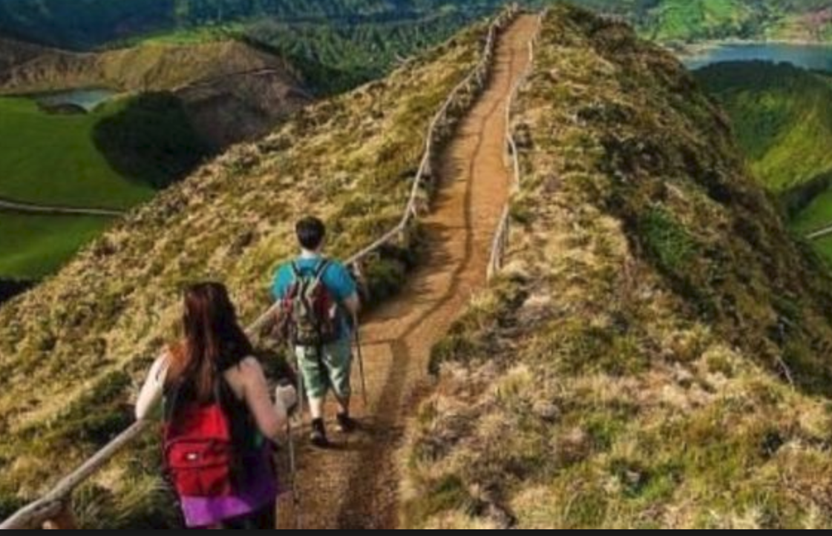
The Future Generations Commissioner for Wales

Slide 6
Our strategic purposes
1. Highlight the big issues, challenges and opportunities facing future generations
2. Support and challenge public bodies to think about the long-term impact of the things they do
3. Work with others to drive the changes needed
4. Walk the talk – be the change that we want to see in others.

Slide 7
Duties and implementation

Slide 8
Applies to Public Bodies and Public Services Boards
Public bodies
Welsh Government
Local authorities
Local Health Boards
National Parks
Fire and Rescue
National (Natural Resources Wales, Arts Council, Sports Council, National library, etc.)
Corporate Joint Committees
Public Services Boards
Local authority
Local Health Board(s)
Fire and Rescue
Natural resources Wales
+ guests (government, police, charities, anyone who can help)

Slide 9
Egwyddor datblygu cynaliadwy Sustainable Development Principle
Yn y Ddeddf hon, mae unrhyw gyfeiriad at y ffaith bod corff cyhoeddus yn gwneud rhywbeth “yn unol â’r egwyddor datblygu cynaliadwy” yn golygu bod yn rhaid i’r corff weithredu mewn modd sy’n ceisio sicrhau bod anghenion y presennol yn cael eu diwallu heb beryglu gallu cenedlaethau’r dyfodol i ddiwallu eu hanghenion hwythau
In this Act, any reference to a public body doing something “in accordance with the sustainable development principle” means that the body must act in a manner which seeks to ensure that the needs of the present are met without compromising the ability of future generations to meet their own needs.

Slide 10
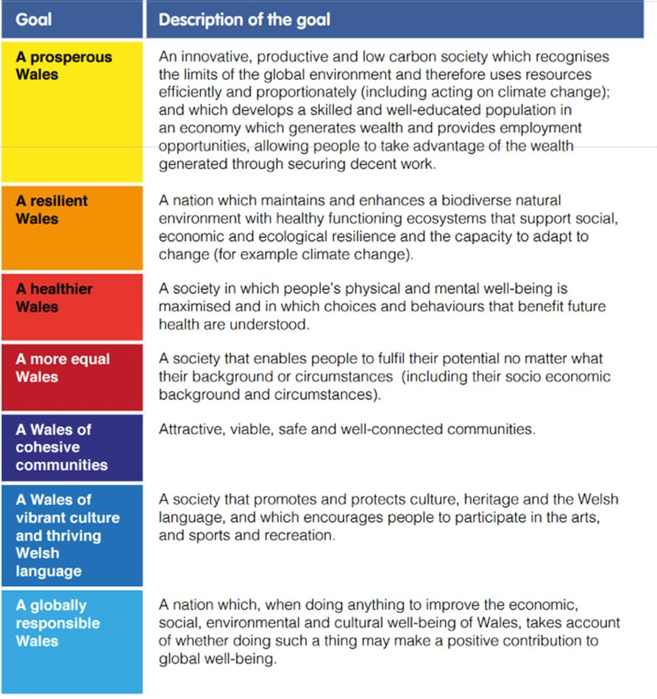
Holistic and innovative nature of the well-being goals

Slide 11
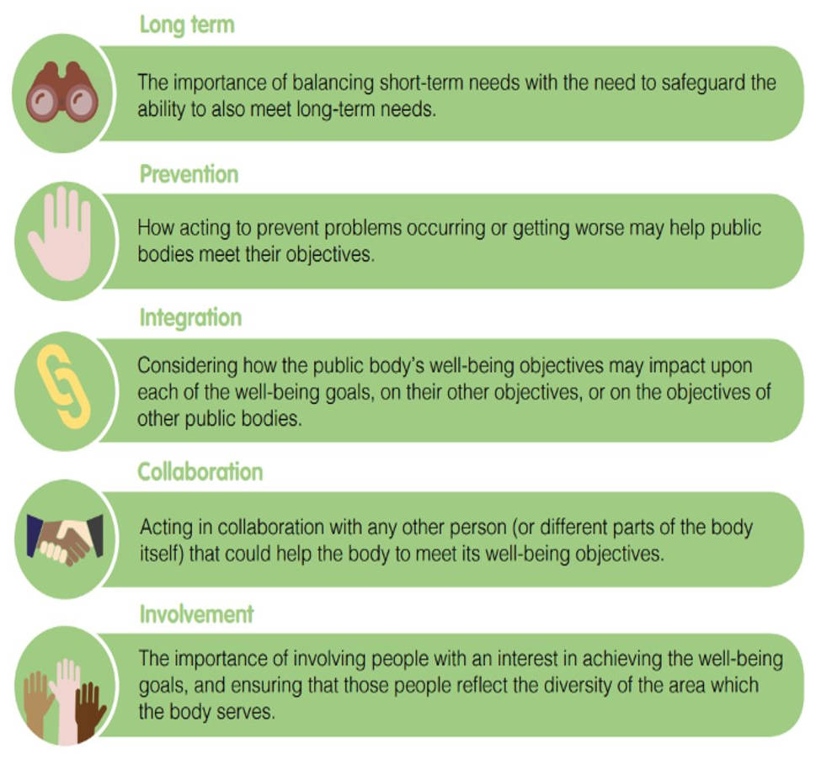
5 ways of working

Slide 12
Public Service Boards: Objectives and Plans

Slide 13
Public Services Boards
Must first conduct local assessments of the local well-being (4 elements of well-being) at least 1 year before the plans​
Publish their plan/ objectives within 1 year after local elections ​
Must set out LOCAL objectives​
Steps proposed to meet them​
Be published with a statement with detailed information on how they will proceed​
FGC must give advice​
Must take into account our Future Generations report

Slide 14
Every Five Years…
Assessments
PSB’s draft well-being plan
Plans
Draft objectives and 14 week advice period with the OFGW
Delivery
Five Ways of Working
Public and OFGW Consultation
Ongoing advice and assistance from OFGW
Reviews and analysis
Public consultation
Final Plans published May 2023

Slide 15
Collaborating with the Voluntary Sector

Slide 16
The Five Ways of Working
Involvement – needs to be embedded in PSB practice as much as possible to empower citizens and include them in decision making processes. The voluntary sector has unique insights and approaches
Collaboration – working across sectors and policy areas to find mutual areas of progress, and break down power differentials between partners
Integration – the voluntary sector are well placed to help public bodies and PSBs understand how different well-being issues (and their causes and consequences) intersect with each other
Prevention – sharing data and insights provides better outcomes for residents and financial savings
Long term – using the voluntary sectors unique insights to demonstrate impacts of future trends on less heard voices

Slide 17
1. Pembrokeshire Pride Awards
A PSB initiative to recognise and celebrate the work of community groups improving Well-being in Pembrokeshire.
Centred around their Well-being plan
Held every other month and awards £200 and a feature in the Western Telegraph
Embeds the Five Ways of Working

Slide 18
2. The Compact, Flintshire
Betsi Cadwalader Health Board
Flintshire Association of Voluntary Services
Flintshire Council
Ensures the public sector are fully aware of the voluntary sector
Promotes partnership working
Oversees a ‘funding code’ to ensure:
Fair treatment by funders
Alignment with public sector priorities
A forum to involve members
“Having a clear methodology when it comes to funding helps the authority and the organisations involved to plan ahead and understand where the local authority wants to be in a certain timescale” – Audit Wales, 2022

Slide 19
3. Vale of Glamorgan – Food Vale
Collaboration include with the Health Board Public Health Team, FareShare Cymru, Big Fresh Cymru, VoG Council, Glamorgan Voluntary Services (and more)
A charter to “build a thriving, healthy and sustainable food system”
Runs projects such as Lantwit Food Project, which seeks to explore and address barriers to accessing good food
Integrated well-being outcomes for participants

Slide 20
Resources:
Future Generations Framework for Projects
Future Generations Framework for Service Design (developed with Welsh Government)
Future Generations Report 2020 – At a Glance
‘A Missed Opportunity’ – Social Enterprises Audit Wales, 2022
Fact sheets on the Well-being of Future Generations Act WVCA
Art of the Possible – early resources and co-creation.
Wales and the Sustainable Development Goals (A supplementary report to the UK Voluntary National Review of progress towards the Sustainable Development Goals 203)

