Slide 1
Bwrdd Gwasanaethau Cyhoeddus Sir Gâr Carmarthenshire Public Services Board

Slide 2
Partneriaid / Partners

Slide 3
Canllawiau a chyngor Guidance and advice

Slide 4
Cylch Gorchwyl Terms of Reference
Paratoi a chyhoeddi asesiad o gyflwr llesiant economaidd, cymdeithasol, amgylcheddol a diwylliannol yn Sir Gaerfyrddin.
Paratoi a chyhoeddi Cynllun Llesiant Lleol ar gyfer y sir yn nodi amcanion lleol a’r camau y mae’n bwriadu eu cymryd i’w cyflawni.
Cymryd pob cam rhesymol i gwrdd â'r amcanion lleol a osodwyd ganddynt.
Paratoi a chyhoeddi adroddiad blynyddol sy’n nodi cynnydd y Bwrdd o ran cyflawni’r amcanion lleol.
To prepare and publish an assessment of the state of economic, social, environmental and cultural well-being in Carmarthenshire.
To prepare and publish a Local Well-Being Plan for the county setting out local objectives and the steps it proposes to take to meet them.
To take all reasonable steps to meet the local objectives they have set.
To prepare and publish an annual report that sets out the Board’s progress in meeting the local objectives.

Slide 5
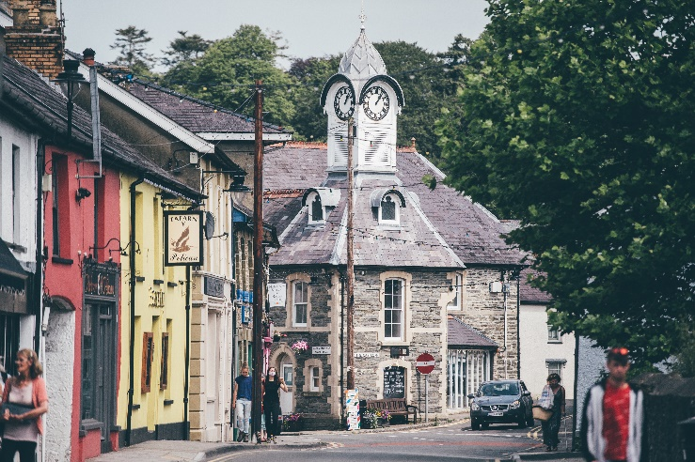
Meysydd gwaith Areas of work

Slide 6
Gweithgarwch diweddar a chyfredol Key recent and current activity
Cyhoeddwyd yr Asesiad o Lesiant Lleol ym mis Mai 2021
Pum Amcan Llesiant wedi’u cytuno
Cynllun Llesiant drafft wedi ei gwblhau
Ymgynghoriad ar y Cynllun drafft tan 25 Ionawr – www.sirgar.gov.uk
Adolygir a chyhoeddir y Cynllun ym mis Mai
Well-being Assessment published May 2021
Five Well-being Objectives agreed
Draft Well-being Plan completed
Consultation on draft Plan until 25 January – www.carmarthenshire.gov.uk
Plan will be reviewed and published in May

Slide 7
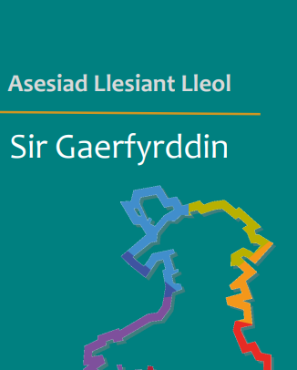
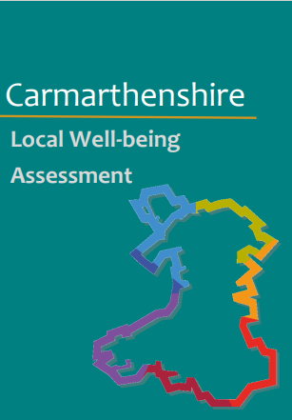

Slide 8
Amcan: Sicrhau economi gynaliadwy a chyflogaeth deg
Objective:
Ensuring a sustainable economy and fair employment

Slide 9
Amcan: Gwella llesiant a lleihau anghydraddoldebau iechyd
Objective:
Improving well-being and reducing health inequalities

Slide 10
Amcan: Ymateb i’r argyfyngau natur a hinsawdd
Objective:
Responding to the climate and nature emergencies

Slide 11
Amcan: Mynd i’r afael â thlodi a’i effeithiau
Objective:
Tackling poverty and its impacts

Slide 12
Amcan: Helpu i greu cymunedau a lleoedd diogel ac amrywiol
Objective:
Helping to create safe and diverse communities and places

Slide 13
Cydweithio gyda’r Sector Wirfoddol Third Sector Collaboration
Helpu i siapio y Cynllun Llesiant drafft drwy gwblhau’r holiadur ar-lein erbyn 25 Ionawr
Ein helpu i adnabod blaenoriaethau
Strwythur gweithredu i’w ddatblygu gan y BGC er mwyn symud y meysydd blaenoriaeth ymlaen
Rhannu gwybodaeth at y dyfodol
Help shape the draft Well-being Plan by completing the online survey before 25 January
Help to identify the priority areas
New delivery structure to be developed by the PSB to progress the priority actions identified in the final Plan
Future information sharing

Slide 14
Cwestiynau / Questions
Diolch / Thank you
Llinos Evans
Tîm Cefnogi’r BGC / PSB Support Team
llinevans@sirgar.gov.uk

